Slide 1
Stage 5: Investigating the requirements of plants for life and growth

Slide 2
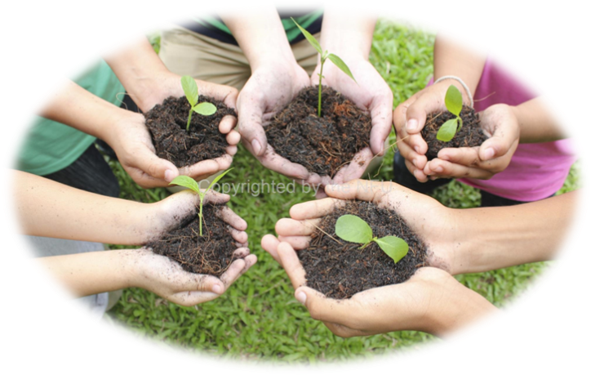
Learning Objectives:
• To design and conduct a fair investigation
• To explore the requirements of plants for life and growth
Read the question on your investigation card carefully and write what you think will happen on a post it note. This is called your prediction.
Put all of your group’s post it predictions in an envelope and seal it- we will open it again at the end of the investigation!

Slide 3
Carrying out a fair test
A fair test is a controlled investigation that compares two things. In order for a test to be fair or well controlled, we have to make sure that only one thing (this is called a variable) is changed and everything else is kept the same.
A variable is anything that can affect the results we are observing or measuring.
In our investigation, we will use two bean plants that are the same age. We will change one variable (something in the plant’s environment) for one plant but not the other. Then we will treat both of our plants exactly the same and observe what happens.
By only changing one thing on one of plants, we can see if that one thing makes a difference to how the plant grows by comparing it with the plant that we have not changed (the control plant).

Slide 4
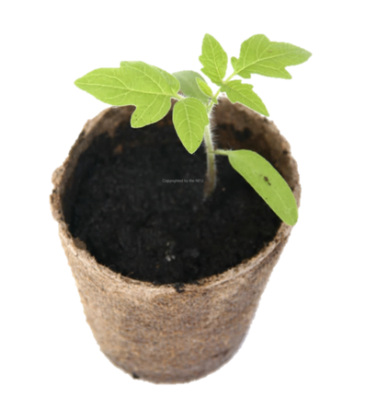
Investigation planning:
Think about how you will conduct an investigation to answer your group’s question.
What will you change for one plant?
How will you check if it is making a difference?
Think about all the things (variables) that you will have to keep the same for both of their plants.

Slide 5
Investigation design
Use the investigation planner to write up your investigation plan.
Use the correct scientific vocabulary and explain why you are changing your variables or keeping them constant.

Slide 6
Your investigation
In your groups, set up your investigation. Don’t forget to label your bean plant as either the control or the experimental plant.

Slide 7
Observation journals
You are going to keep an observation journal. Every time you water your plants, observe them closely and record any differences that you notice.
Include a diagram for each of your journal entries.

Slide 8
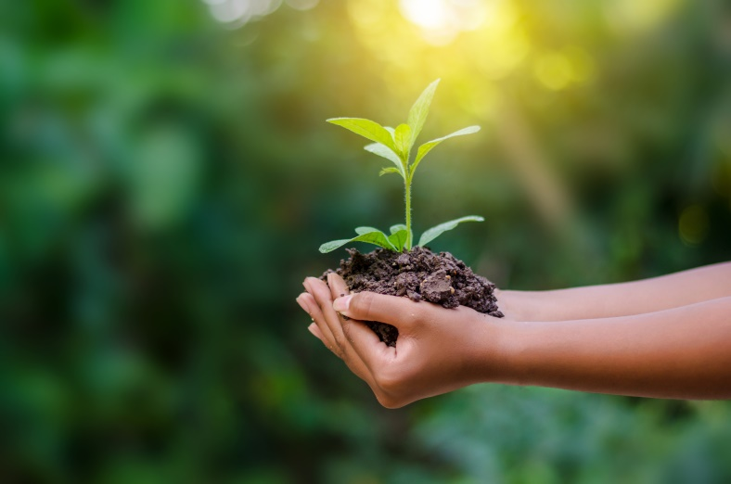
Your conclusion
Explain what you found and why you think this happens.
What does this tell you about the functions of different parts of a plant and what plants need to live and grow?
Open your prediction envelopes- were you correct?

Slide 9
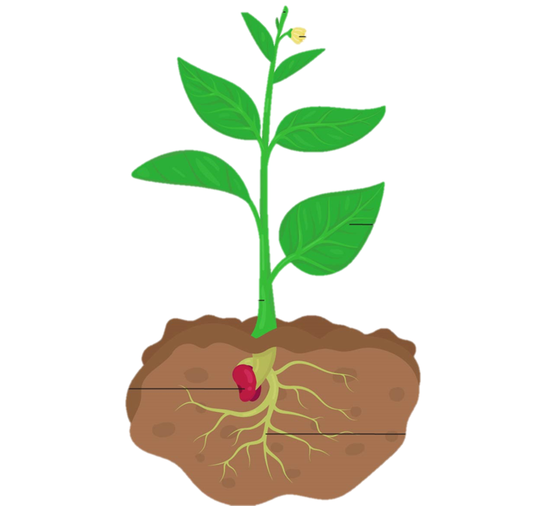
The root
Plants need roots for two important reasons:
They act as an anchor to hold the plant in the soil.
They take up water and dissolved minerals from the soil.
If we take away a plant’s roots, the plant could easily be blown away or knocked over and the plant would not be able to absorb water and minerals from the soil.

Slide 10
Leaves
Plants need leaves to make their own food.
Leaves trap energy from the sun which is used to produce sugars. The plant breaks down these sugars to give it energy. This process is called photosynthesis.
If we take away a plant’s leaves, photosynthesis will not take place and the plant will not be able to make its own food.

Slide 11
The stem
Plants need stems for three important reasons:
They hold the leaves and flowers above the ground so that leaves can get sunlight and flowers can attract insects.
They help to transport minerals and water from the roots to the rest of the plant.
They help to carry sugars away from the leaves.

Slide 12
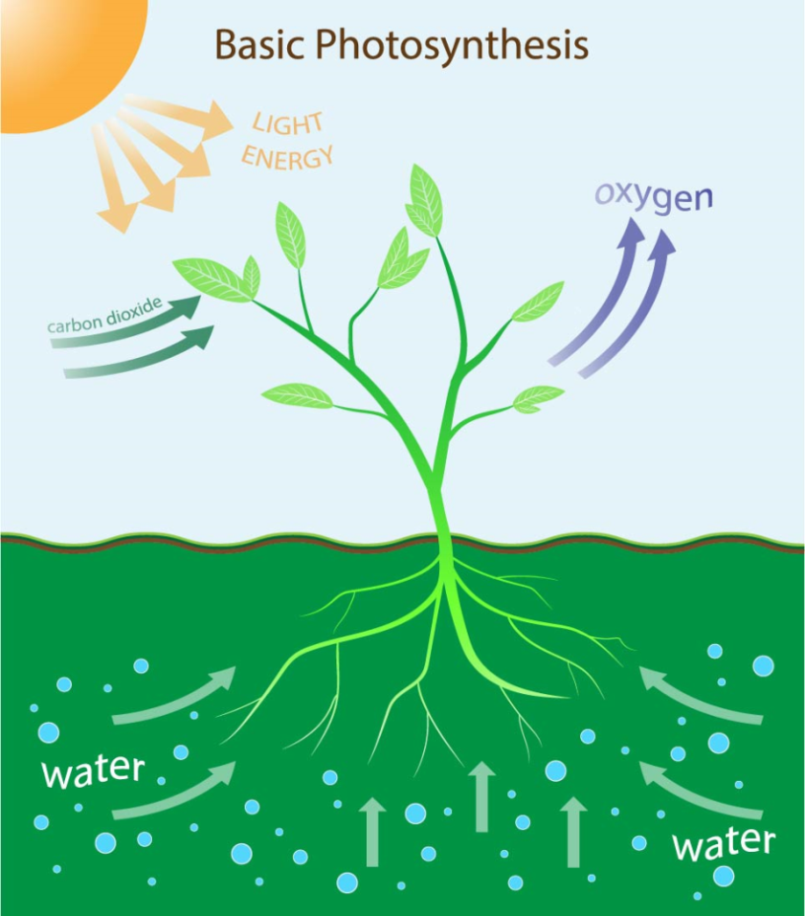
Why do plants need water and sunlight?
To make their own food in the leaves, plants need water and sunlight.
If plants do not have water and sunlight then photosynthesis cannot take place and the plants will die.

Slide 13
Presentation time!
Use what you have learnt to prepare a short presentation explain your investigation and what you found.
Remember to include:
Your question
What you changed
What you kept the same
What you observed
Why you think this happened

